Slide 1

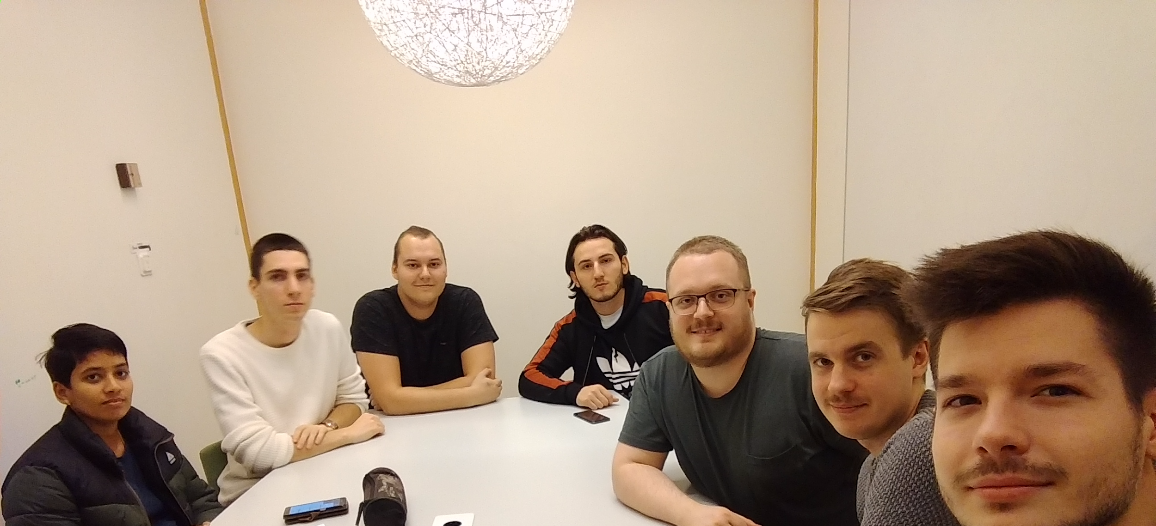
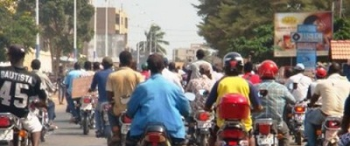
Boda Boda -
Motorcycle taxis in East Africa

Slide 2
AGENDA
During this presentation :
INTRODUCTION
Initial backlog
Functional requirements
Non-Functional requirements
Roles & Responsibilities
Work Organization
Work Distribution
Client Interaction
Meetings
1

Slide 3

INTRODUCTION : Client
Client : OKAPI finance
Bank the unbanked by providing :
Providing financial inclusion
Increasing access to financial services
Minimizing transaction charges
Global money transfer company
Offering affordable cash transfer services
2

Slide 4
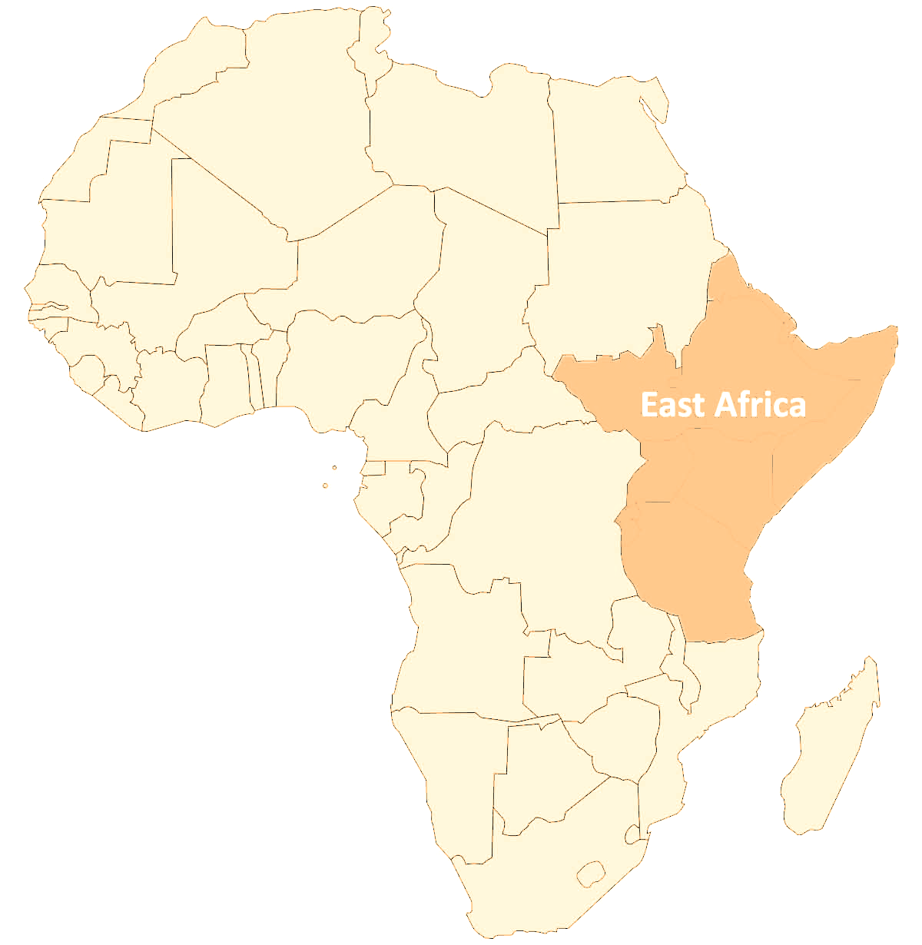

INTRODUCTION : Product
BodaBoda : Mobile phone application in East Africa
Goal : Matching motorcycle taxi drivers and customers
Customer :
Customers could find the closest free driver
Find cheapest price
Know who is willing to drive them to their destination
Driver :
Driver could state that they are free
Accept a request
App :
Track the driven distance
Calculate a price
Handle the payment
3

Slide 5
INITIAL BACKLOG
Requirements - The overall requirements (SRS) of the project
Diagrams
Beginning stage : Diagrams that will help the group and stakeholders to understand the functionality of the system.
Later stages :
More Activity diagrams
Class diagrams
Sequence diagrams
4
Notes:
What is in the initial backlog?

Slide 6
FUNCTIONAL REQUIREMENTS
Guest
Account registration
Login
Customer
Modify account information
Request a trip
Pay for a trip
Canceling a trip
See payment verification
Become a driver
Driver
Modify account information
Change to availability status
Accept ride requests
Navigate to the customer
Set a mileage price
Set a fee price
Initiate the ride
End the ride
See payment verification
5
Notes:
What is in the initial backlog?

Slide 7



NON-FUNCTIONAL REQUIREMENTS
Performance
Support of multiple users
At least 98% uptime
Security
Encrypt the user passwords
Encrypt the user payment information
Verifying user permission
Verifying user login
Software Quality Attributes
Reliability
Usability
Long battery life
Maintainability
6
Notes:
What is in the initial backlog?

Slide 8
ROLES & RESPONSIBILITIES
NAME | ADDRESS | SPECIFICITY
Aleksandar acimovic | acimovic.alek@gmail.com | Project Manager, Developer
Zacharias Leo | zlo16001@student.mdh.se | Worktime tracker, Developer
Jonathan Major | jmr16009@student.mdh.se | Trello responsible, Developer
Chingiz Esenbaev | tjv15001@student.mdh.se | Presentation responsible, Developer
Linus Sens Ingels | lis16001@student.mdh.se | Client communication, Developer
Stanislas Pedebearn | spn18013@student.mdh.se | Template creator, Developer Presentation assistant
Sireesha Kumari KulaR | ski18005@student.mdh.se | Developer
7
Notes:
What are the roles and responsibilities in your group? Do you have any particular roles which may be specific for your project?

Slide 9







WORK ORGANIZATION
Weekly meetings
Time reporting
8
Notes:
How will you organise the work?

Slide 10
RISK MANAGEMENT
Creating a Risk Management Plan is a critical step
Possible risks:
Data loss
Misinterpretation of client requests
Missing the internal scheduled deliverables
Lack of communication within team
Estimation of resources
9
Notes:
How will you organise the work?

Slide 11
WORK DISTRIBUTION
Divided by knowledge of the members and all members are equal
Main points of work distribution are:
Equal amount of work
Job in his area of expertise
Reasonable amount of time to complete it
Tasks can be completed in :
Sequential way
Parallel way
Project plan | 22 november
Design description V1 | 6 december
Product V1 | 6 december
Project report | 17 January
Design description V2 | 17 January
Product V2 | 17 January
Project plan and requirement | 28 november
Preliminary design and implementation | 12 december
Final presentation | 16 january
10
Notes:
How will you organise the work?

Slide 12
CLIENT INTERACTION
First interaction by email
Meetings are organised
Requirements, implementation and design will primarily be discussed
If any question or design / implementation problems -> we can task about it with her
We check if the client is satisfied each week
11
Notes:
How have you interacted with the client? (How many meetings, how did you prepare, etc.) Did the client provide detailed requirements or did you start from a high-level idea and defined the initial backlog jointly? Did you have to negotiate the project scope and how did you establish the priority of different features?

Slide 13
MEETINGS
Meetings when necessary i.e. not on any fixed days.
Discuss & Prioritize the tasks to be completed.
Divide the tasks and responsible persons.
Decide internal deadlines for completing the tasks.
If something is unclear or is of high priority the group will try to schedule a live meeting, so the solutions of the problems can be discussed and implemented as fast as possible.
12
Notes:
What are the routines for communication and synchronization in the group (e.g. weekly meetings on fixed days, and what will you do in those meetings)?

Slide 14
?
?
?
QUESTIONS ?
7

